Slide 1

Credit Rating Agencies
By Ayoub DAOUD & Issa KACHAOU
Notes:
A rating agency assesses the ability of a borrower—be it a company, a state, or a local authority—to repay its debt. The three main agencies are Moody's Investor Service (Moody's), Fitch Ratings (Fitch), and Standard & Poor's. Recently, Scope Ratings, a European agency, has been approved by the European Central Bank.
Rating agencies exist because risk comes at a price, known as the risk premium, which is added to the interest on a debt. The riskier a debt security is, the lower its rating will be. Thus, the rating assigned by a rating agency directly influences the price of the debt.
The highest rating is triple A. In response to criticism aimed at these agencies, the European Union has implemented stricter regulations for them since 2008.

Slide 2
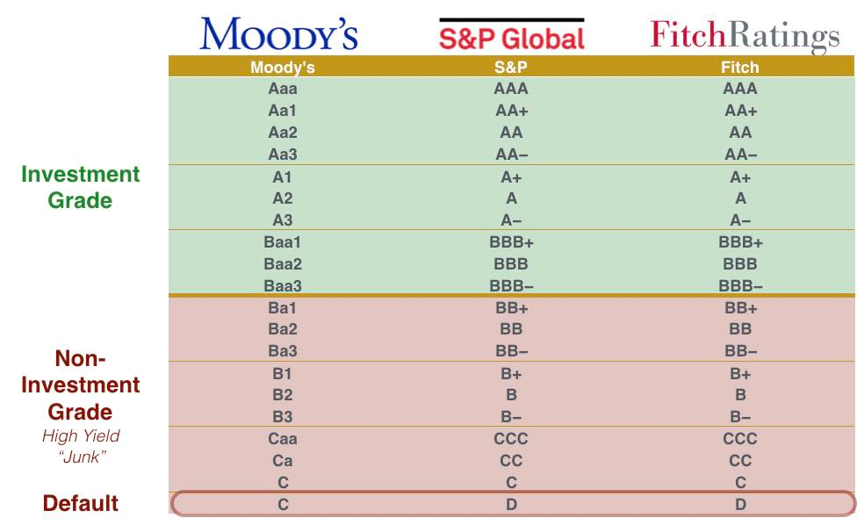
1. Introduction to Credit Rating Agencies
Credit rating agencies (CRAs) assess the ability of borrowers—companies, states, or local authorities—to repay their debt.
The main agencies include:
Moody's Investor Service (Moody's)
Fitch Ratings (Fitch)
Standard & Poor's (S&P)
Scope Ratings, a European agency, was recently approved by the European Central Bank.
Notes:
Credit rating agencies (CRAs) are private companies whose main activity is to evaluate the ability of debt issuers (such as companies, states, and local authorities) to meet their financial obligations. They exist because risk has a price, known as the risk premium, which is added to the interest on a debt. The role of these agencies is to assess this risk premium.
The first rating agencies emerged in the 1920s. Their activity of selling financial information is similar to that of financial analysts. Following the 1929 crisis, these agencies began to focus on analyzing the credit quality of issuers or borrowers. The three main agencies are Moody’s Investor Service (Moody’s), Fitch Ratings (Fitch), and Standard & Poor’s (S&P).
Various financial scandals (such as the Enron case in 2001 and the financial crisis of 2007-2008, which affected the U.S. mortgage sector, known as the subprime crisis) have highlighted the risks associated with the role of rating agencies in the financial system.

Slide 3
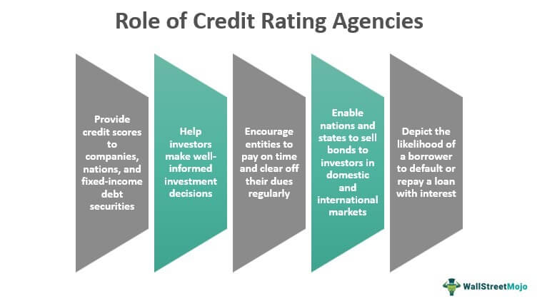
2. The Role of CRAs
CRAs evaluate the risk premium associated with debt, which influences interest rates. The highest rating is AAA.
CRAs emerged in the 1920s, focusing on credit quality post-1929 crisis.
Financial scandals like Enron and the subprime crisis revealed risks in their assessments.
Notes:
Credit rating refers to the activity of publishing an assessment of an borrower’s risk of default. The agency evaluates whether the borrower is solvent and will be able to repay their debt. To measure the risk of non-repayment, they construct financial forecasts that include the future structure of the borrower’s costs and revenues. It’s important not to confuse credit rating agencies with auditing firms that verify and certify company accounts.
Key criteria used to assess financial risk include overall financial profitability, return on invested capital, debt levels, financial flexibility, and liquidity. More recently, non-quantitative criteria such as governance, corporate social responsibility, and strategy have also come into play.
The three major rating agencies are of Anglo-Saxon origin and are rooted in that culture. This positioning is justified by the size and importance of Anglo-Saxon capital markets, but it can sometimes make it more difficult to account for regional particularities. For example, commitments related to employee pensions are classified by Anglo-Saxon accounting as loans or obligations, which may seem somewhat restrictive.
Rating agencies play a critical role in financial markets, but they face significant scrutiny and regulatory challenges.

Slide 4
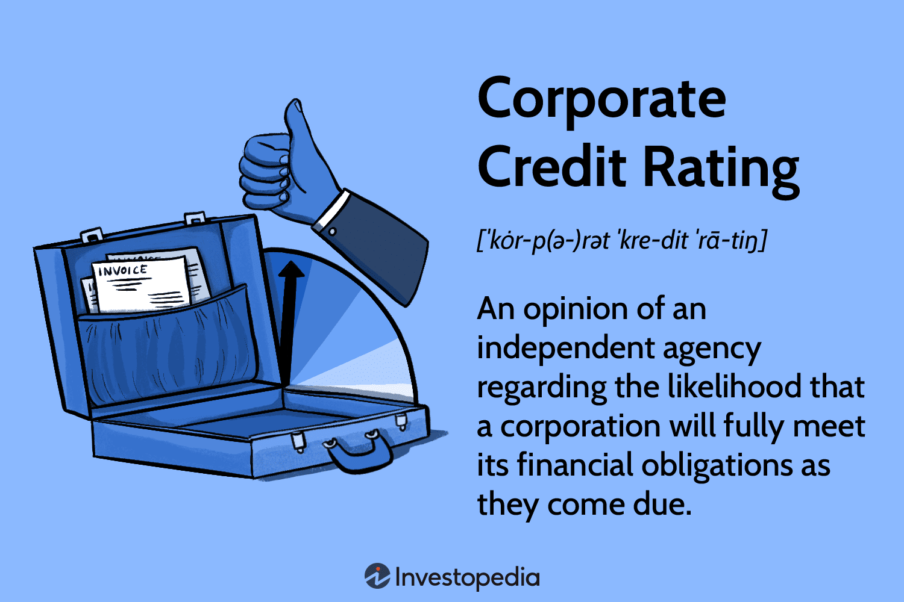
3. Credit Ratings Explained
Credit ratings assess a borrower's risk of default. Key criteria include:
Financial profitability
Return on invested capital
Debt levels
Financial flexibility
Liquidity
Non-quantitative criteria like governance and corporate social responsibility are increasingly important.

Slide 5
4. Importance of Ratings
Ratings influence a company’s ability to secure financing. Higher ratings lead to lower interest rates.
For example, France's rating was downgraded to "AA-" by Fitch in April 2023.

Slide 6
5. Criticisms of Rating Agencies
Criticisms include:
Conflicts of interest due to the issuer-pays model.
Lack of transparency in rating methodologies.
Failure to predict declines in borrower solvency.
The EU has implemented regulations to improve oversight and transparency since the 2008 crisis.

Slide 7
Conclusion
"Following the 2008 crisis, the European Union implemented regulations in 2010 to enhance oversight of rating agencies, requiring them to register in their operating countries and to publicly disclose their models, methodologies, and key assumptions."

